Slide 1
Analysis of Bank Marketing Campaign
INFO 5082
Naveed Iqbal Mohammad

Slide 2
Aim
Predict realistic consumer interest in the marketing campaign from the data
Data Source
Collected and Uploaded on the UCI Machine Learning repository by the Portuguese bank.

Slide 3
Data
20 Input variable and one outcome variable
Client’s data: Age, Job, Education, Default, Housing, Loan
Campaign (Current) Data: Contact, Month, Day_of_Week, Duration
Campaign (Previous) Data: Campaign, Previous, Poutcome, Pdays
Socio-Economic Data: Emp.var.rate, Cons.price.idx, cons.conf.idx, Euribor3m, nr.employed
Output Variable: y

Slide 4
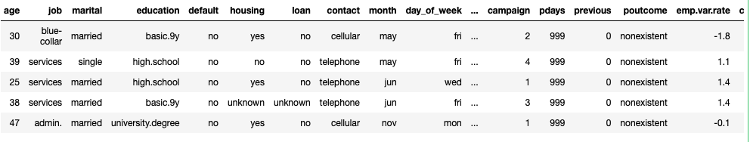
EDA
Data has 10 Categorical variables and 10 Numerical variables
Categorical Variables: Job, Martial_status, Education, Contact, Month, Day_of_week, poutcome, default, housing, loan
Numerical Variables: Age, Campaign, pdays, previous, emp.var.rate, cons.price.idx, cons.conf.idx, euri.bor.rm, nr.employed, duration
Outcome: Y

Slide 5
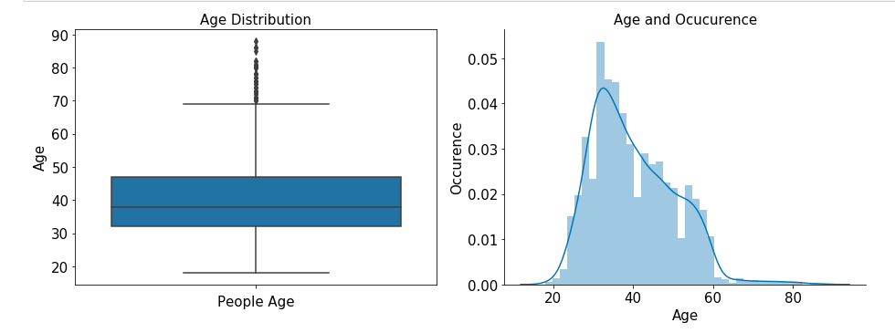
Age

Slide 6
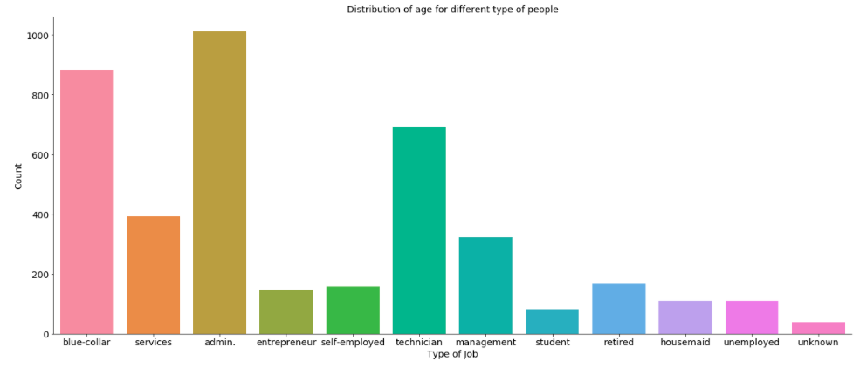
Jobs:

Slide 7
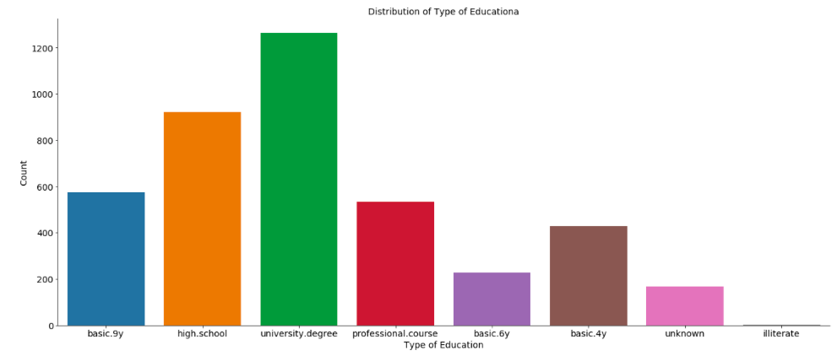
Education

Slide 8
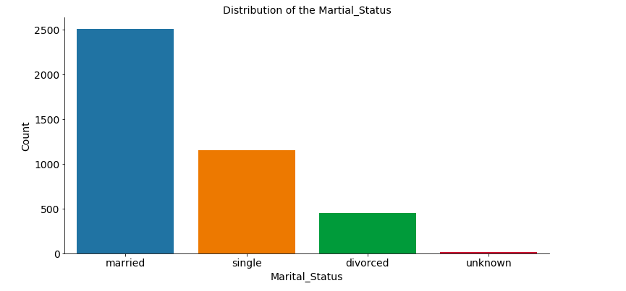
Martial Status:

Slide 9
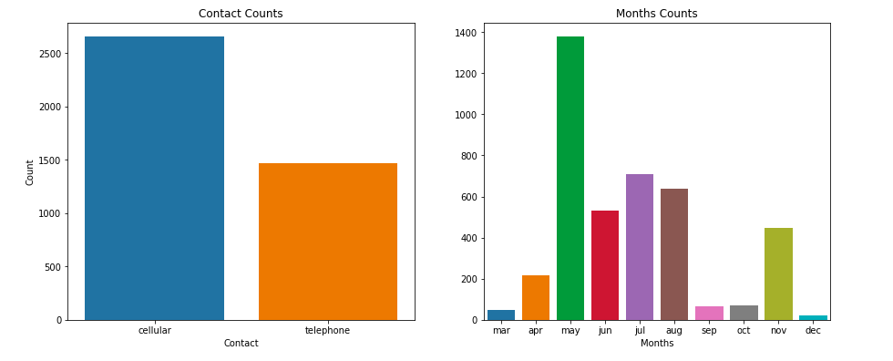
Contact Month and Type

Slide 10
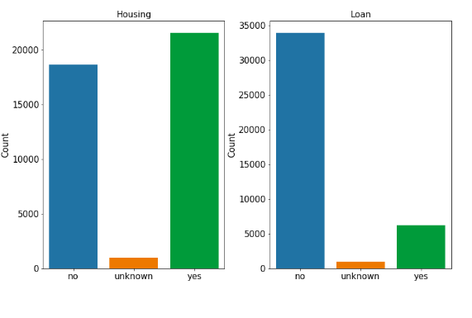
Personal and Housing Loan:

Slide 11
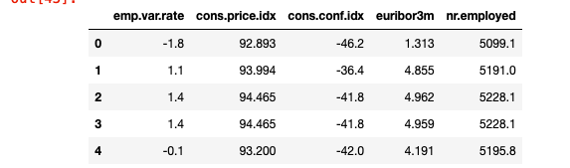
Social Indices:

Slide 12
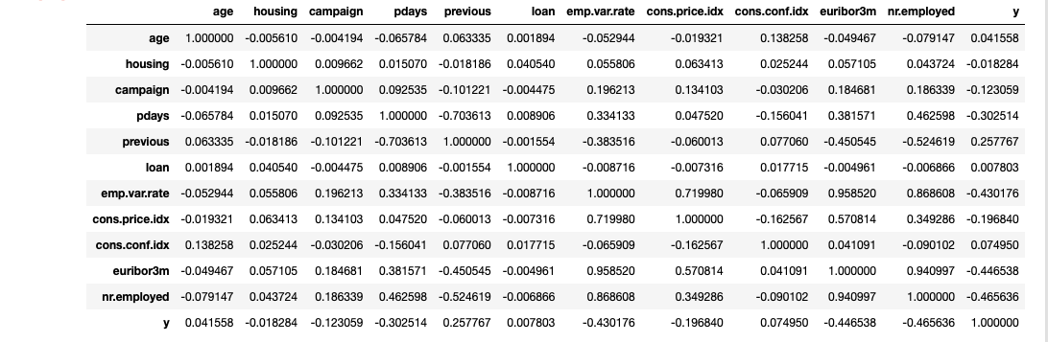
Correlations Between variable:

Slide 13
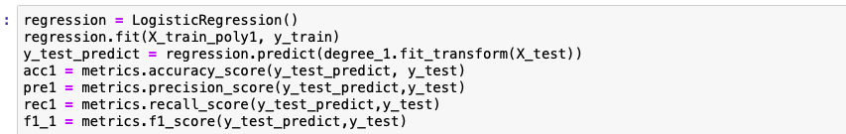
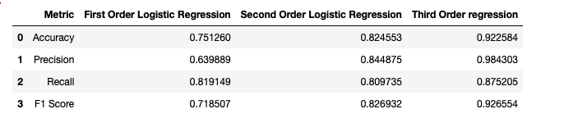
Logistic Regression Model:
Output:

Slide 14
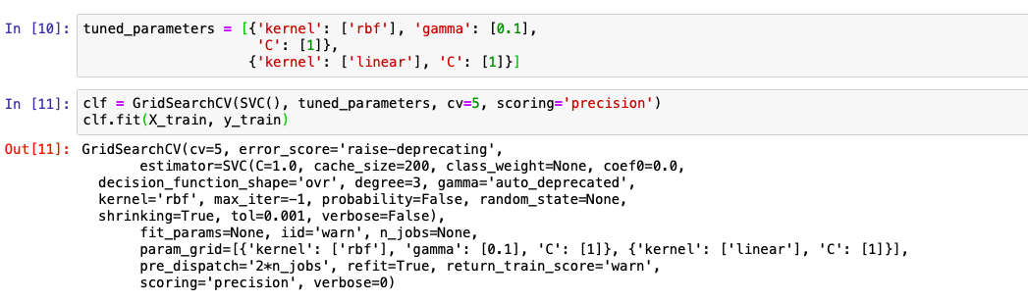
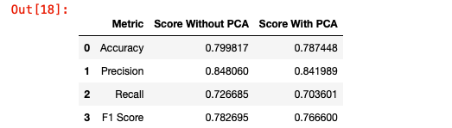
Support Vector Machine:

Slide 15
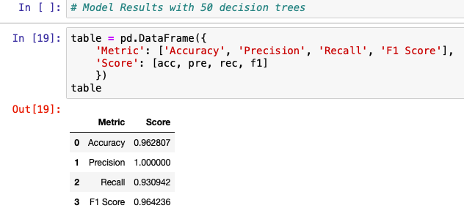
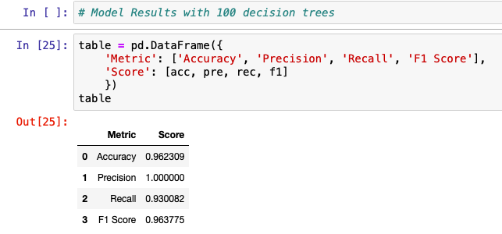
Random Forest Classifier:

Slide 16
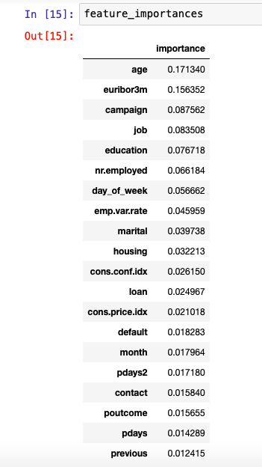
Feature Model selected:

